Slide 1

Identifying Factors Leading To Drugs Use In Youths
Metis
Data Science Bootcamp
Project 5
Presented by : Li Xinni
Notes:
Good morning everyone , i’m Xinni. When you see a drug addict, have you ever wonder when it all begins? How did a innocent child grow up to gets addicted to drugs? For many, drug addiction started when they were at their teens. In this project I hope that i will be able to use data on youth behaviour to discover the factors that lead to drug use and how we can use our findings to help for these youth at risk.

Slide 2



Overview
01
04
02
05
03
06
DATA COLLECTION AND TARGET
EVALUATION
Data source and exploration , Finding Target
Selected features , model & Evaluation
DATA PREPROCESSING
SOLUTIONS
Handling of Missing data
How our findings can be applied in school?
METHODOLOGY
Feature selections and modeling
CONCLUSIONS
Seaborn
Matplotlib
Notes:
Here’s an overview of the presentation today, using the tools on the right, we will begin with

Slide 3

Data Collection
Anonymous Survey
13,677 Students (14-18 years old)
99 Questions on
Focusing on Risky Behaviours
Unintentional injuries and violence behaviors
Sexual behaviors
Alcohol
Drug use
Tobacco use
Notes:
Using the youth risk Behaviour Survey conducted by the US Centers for Disease Control. Anonymous survey that contains 99 questions asking students on their behaviours which focus on risky behaviours such as violence, alcohol and drugs use.

Slide 4
Sample Questions
Because of a physical, mental, or emotional problem, do you have serious difficulty concentrating, remembering, or
making decisions?
Yes
No
Categorical
During your life, how many times have you used ecstasy (also called MDMA)?
A. 0 times
B. 1 or 2 times
C. 3 to 9 times
D. 10 to 19 times
E. 20 to 39 times
F. 40 or more times
Ordinal
Notes:
Here’s some of the sample Questions which show answers that are categorical and ordinal.

Slide 5
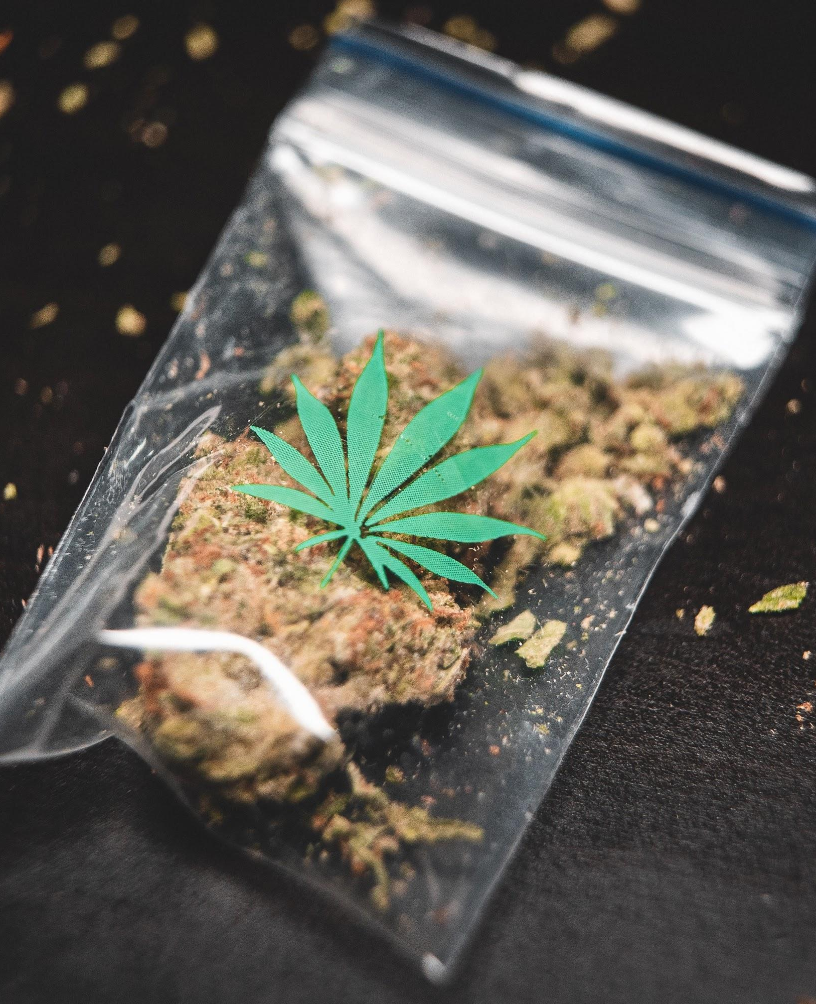
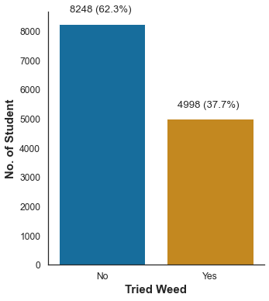
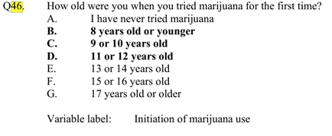
The Gateway Drug
Marijuana aka ‘Weed’ regarded as a "gateway drug." which lead to the use of more dangerous drugs (NIDA, 2020)
Negative impacts on (NIDA, 2020)
Attention
Memory
Learning
Notes:
With some research done, i discovered that Marijuana has been regarded as a "gateway drug." which is often the 1st drug people attempt ,it can then lead to the use of more dangerous drugs such as cocaine. Although majority of people who use marijuana do not go on to use other, “harder” substances. Using weed can have negative effects to a young developing brain and affect their ability to cope in school. I created a target based on qn 46 labelled as answers A as 0 and other answers as 1. Despite being illegal for anyone below 21 years old in US to use Marijuana, there is a shocking no. of 37.7 % of students who have tried weed before. *change title

Slide 6
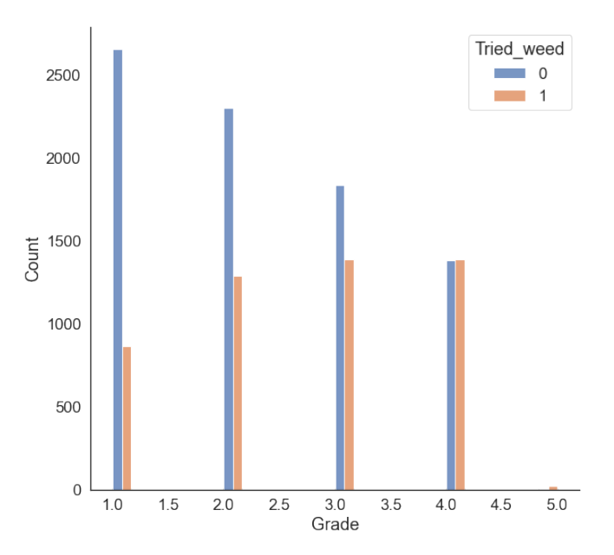
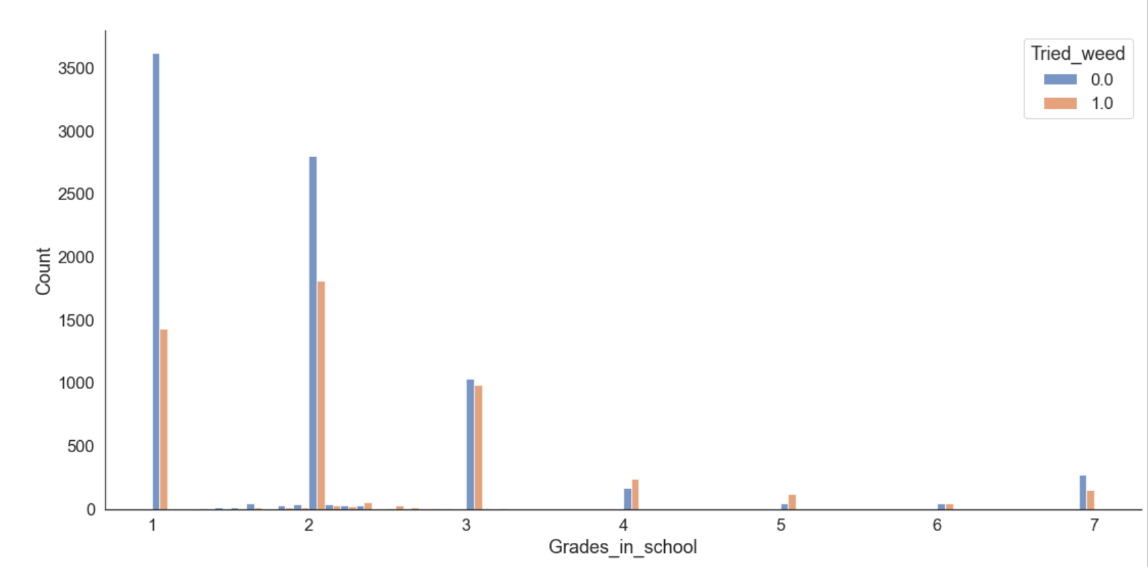
Exploratory Data Analysis
From Grade 10
Age 15 - 16
Grades below C
Notes:
Let’s see if there is some relationship that we can spot by looking at the students behaviour. We notice that the proportion of students have tried weed started increasing in Grade 10 when they are only age 15 ,16 years old . Also notice that more students that do not do so well in school have tried weed.

Slide 7
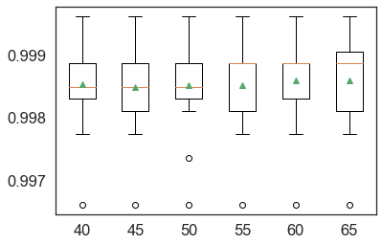
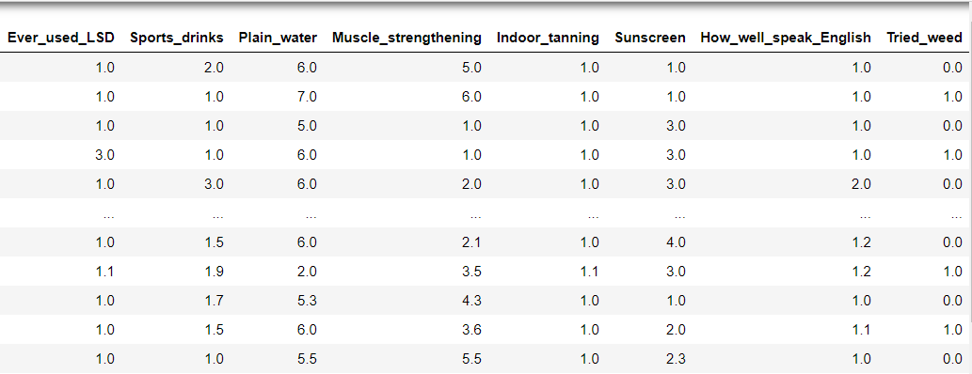
Data Preprocessing
Box and Whisker Plot of Imputation Number of Neighbors
For Missing data
KNN imputer - A similar imputation methodology that works on data is k-Nearest Neighbours (kNN) that identifies the neighbouring points through a measure of distance and the missing values can be estimated using completed values of neighbouring observations.
Target
Snippets of cleaned data 13246 rows × 137 columns
Notes:
For our data preprocessing ,1st i Drop columns that have high multicollinearity. We notice there are many cells with missings values. Since birds of a feather flock together, i decided to use the KNN imputer to predict how similar students will answer the missing data. To decide on no. of nearest neighbor , I tried different values of K and measure its accuracy compare with our target. From the box plot k of 40 is able to give an accuracy of 99.9%. After imputing the missing data, rounding the numbers and creating dummy variables for categorical data. We get the cleaned data below.

Slide 8
Methodology
Train / Test
Model Selection
Split into 80% 20% And scale
Accuracy , Precision , F1 score , ROC AUC score
02
04
01
03
05
Features Selection
Tune Models
Evaluation
Randomized search cv (cv=10) to tune hyperparameters of the models
Confusion Matrix , ROC Curve
Correlation
Lasso
Random forest
Notes:
Now with our clean data, we begin our features selection, we try features selected from correlation to the target, lasso and random forest. Then we split the data and try them with different models and tuning the models using randomized search cv . then we look at the scores for our model selection and evaluate the model

Slide 9
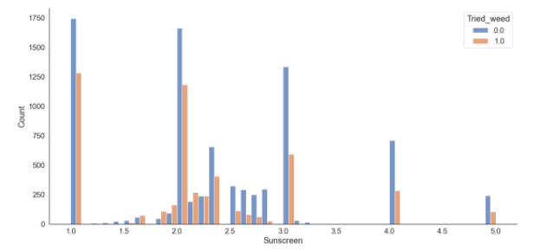
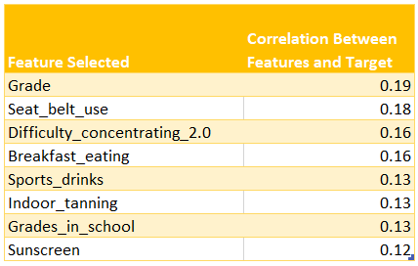
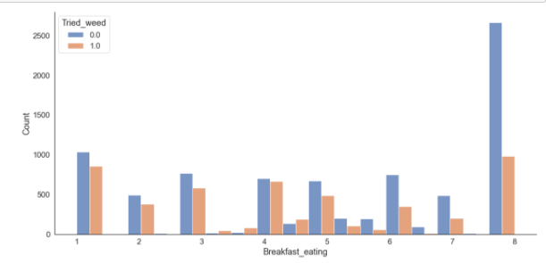
Results
Don’t / Rarely use sunscreen
Don’t eat breakfast everyday
Notes:
We choose the features selected based on the correlation. We noticed some unexpected features where students who don’t or rarely use sunscreen and don’t take breakfast regularly actually have a higher tendency to try weed. These 2 factors could be an indication of lacking in self and family care.

Slide 10
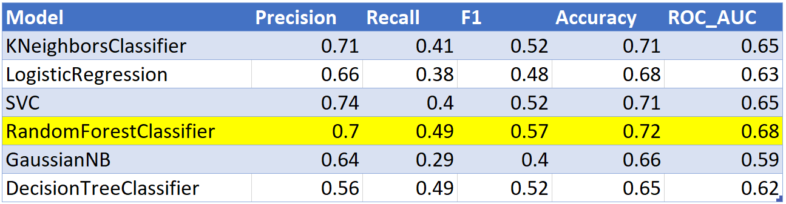
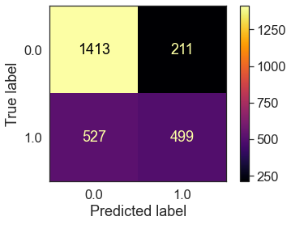
Results
Model selected
Evaluation
Notes:
Our best model is the random forest classifier which has 4 out of 5 high score . It is able to give us a precision of 0.7 which means out of the all students predict to take weed (show in confusion matrix) 70% really do. * Highlight the precision score and how the confusion matrix means

Slide 11
Proposed Solutions
Create a survey using features selected to predict if the student is likely to try weed.
Early intervention
Provide support
Drug education
Notes:
Now that we have identified the factors relating to drug taking we can create a survey with these features to predict if the students are likely try weed. Provide early intervention , guide and give them support and , educate them on the dangers of drugs.

Slide 12

CONCLUSIONS & FUTURE WORK
Conclusion
Lack of self-care and family care
Early intervention
Provide support
Drug education
Future work
Better data collection
Schools to use full set of questions
Predict with other risky behaviours
Notes:
In conclusion, we found out that lack of self-care and family care are factors leading to drug use. Using our survey, we could identify youth who are likely to take drugs and provide early intervention. Everyone has a part to play in shaping our younger generation so they do not become victims of drug abuse. It is easy to get hook at a young age & their lives will be ruin as it takes a lot of self-discipline to quit drugs.
From the dataset, I noticed that some school that did not ask students the full set of questions resulting in cluster of missing data. So for future work, we need to have better data collection. We can also see how we can predict if student are taking drugs from other risky behaviours.

Slide 13
REFERENCES
NIDA. "Is marijuana a gateway drug?." National Institute on Drug Abuse, 8 Apr. 2020, https://www.drugabuse.gov/publications/research-reports/marijuana/marijuana-gateway-drug
Accessed 16 Nov. 2020.
NIDA. "How does marijuana use affect school, work, and social life?." National Institute on Drug Abuse, 11 Jun. 2020, https://www.drugabuse.gov/publications/research-reports/marijuana/how-does-marijuana-use-affect-school-work-social-life Accessed 16 Nov. 2020.

Slide 14

THANK YOU!
Do you have any questions?
Connect via
sabrinalixinni@hotmail.com
https://sablxn.medium.com/
www.linkedin.com/in/sablxn
https://github.com/sablxn
Please keep this slide for attribution
Notes:
I have come to the end of my presentation. Thank you for your time today, feel free to reach out to me via the following platforms. Thank you.

